Slide 1
IP Management in Clinical Trial
Presented by:-Aarti Yadgire
Digvijay Patil

Slide 2
Content
Investigational Product
Why IP Management is Important
Responsibilities of Sponsor in IP management
Responsibilities of CRO in IP management
Responsibilities of Investigator in IP management
6. Responsibilities of Subject in IP management
7. Documentation of IP
8. Re-labelling and Reconciliation of IP
Returning and Destruction of IP

Slide 3
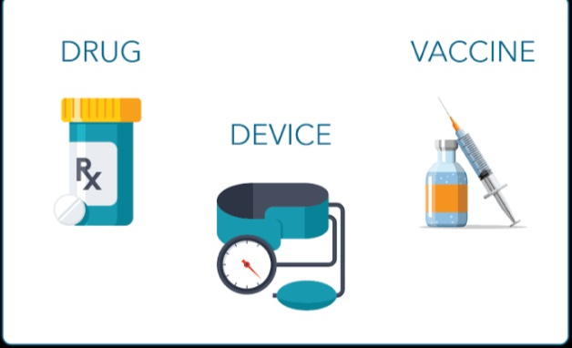
Investigational Product :-
Investigational Product is a pharmaceutical form of an active ingredient or placebo being tested or used as a reference in a clinical trial.
It can be a Preventive (vaccine), a therapeutic (drug or biologic), device, diagnostic, or palliative

Slide 4
Why IP management is Important
It validates dosage and safety
IT is used for evaluation of safety and efficacy in human subjects
To ensure Inspection readiness

Slide 5
Sponsor Responsibilities with reference to IP (1/2)
Manufacturing : IP should manufacture in accordance with applicable GMP
Labelling:- Labelling of IP should comply with applicable regulatory requirements and is coded in manner that protects blinding
Packaging :- packaging of IP should be such that it prevent from contamination and unacceptable deterioration while transporting and storage
Storage :- IP should stored in acceptable storage condition and temperature
Supplying:- IP is supplied by sponsor to investigator it can not be supplied until sponsor obtain all required documents
Handling :- Written procedures including instructions should be provided by sponsor to the investigator related to handling of IP

Slide 6
Sponsor Responsibilities with reference to IP (2/2)
Ensure timely delivery of IP to the investigator
Maintain records of document shipment , receipt , disposition , return and destruction of IP
Maintain a system for retrieving IP and documenting it
Maintain system for disposition of unused IP and documenting it
Ensure that the IP should be stable over the period of use
Maintain sufficient quantities of IP used in trial

Slide 7
CRO Responsibilities with reference to IP (1/1)
Ensure presence of essential documents related to the IP
Qualification visit at site
Training to site related to protocol / IP/ IP record
To ensure storage conditions related to IP are followed according to instruction provided by sponsor

Slide 8
Responsibilities of Investigator in IP management (1/1)
Investigator should verify the IP for correct amount ,temperature and integrity of product
Ensure that all persons handling IP are properly trained and delegated in duties
TO check content and condition of IP
Review any discrepancies in documents
Verification of expiry dates match to sponsor’s updated information
Ensure that IP is stored according to protocol
Follow sponsor’s instruction to report any temperature deviation identified after arrival of IP at site
Verify that the correct amount of IP is received

Slide 9
Responsibilities of Subject in IP management (1/1)
Subject should follow instruction given by investigator or site staff related to
ID number
Route of administration, time , dose
Patient diary
Storage conditions
Expiry date
Concomitant medication
Reporting of AE on time

Slide 10
Documentation of IP ( 1/2)
IP details recommended for documentation includes :-
IP name , strengths
Quantities received , dispensed , returned from subject, returned to Sponsor , destroyed
Batch/ serial numbers
Expiration dates
Investigator , site, protocol number
Unique code numbers for all IP and subject

Slide 11
Documentation of IP (2/2)
Dosing instructions as per protocol
Subjects compliance
Inconsistencies, and explanation provided by subject
Action taken to address inconsistencies
Date of destruction / return to sponsor

Slide 12
Re-labeling and Reconciliation of IP
Re-labeling :- At site , the IP may need to re-labelled to show updated details, should follow re-labeling instructions and document the re-labeling procedure
Reconciliation:- IP reconciliation is the process of accounting for all the IP provided by sponsor to the throughout the study
Reconciliation process generally followed is:-
Calculate the total amount of IP received from sponsor as per signed receipts.
Count empty, partially empty and unused packaging units returned by subjects
Compare and if any missing units must have documented explanation

Slide 13
Returning and Destruction of IP
Returning of IP:- IP return refers to subjects returning unfinished/ unused/ used up IP to study site also refer to subsequent returning of these items from study site to the sponsor.
Destruction of IP:- IP can be destroyedonly with prior written authorization from sponsor
Destruction can be conducted at:
Investigational site
Local third party contractor
Sponsor facilities
Written destruction procedure and evidence of destruction of every unit of IP destroyed must be available for review

Slide 14
Reference
ICH E6(R1)Guidelines For GCP E6(R2)

Slide 15
Thank you

